Slide 1
PIPELINING
Pipelining is a technique of decomposing a sequential process into sub-operations, with each sub-process being executed in a segment that operates concurrently with all other segment.

Slide 2
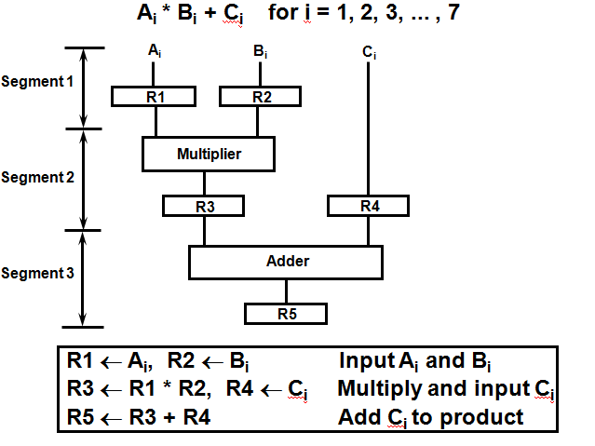
Example for Pipeline Processing

Slide 3
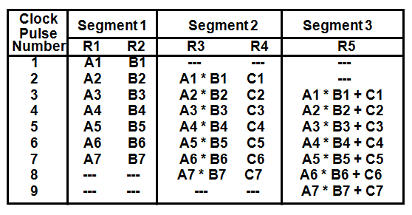
Operations in each pipeline stage

Slide 4
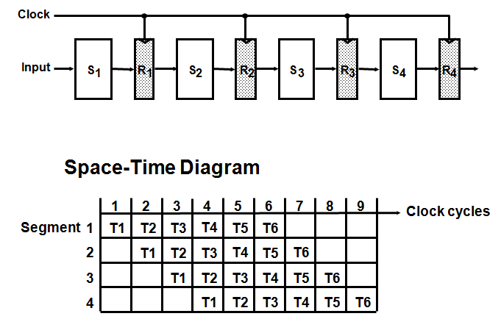
General Four-Segment Pipeline

Slide 5
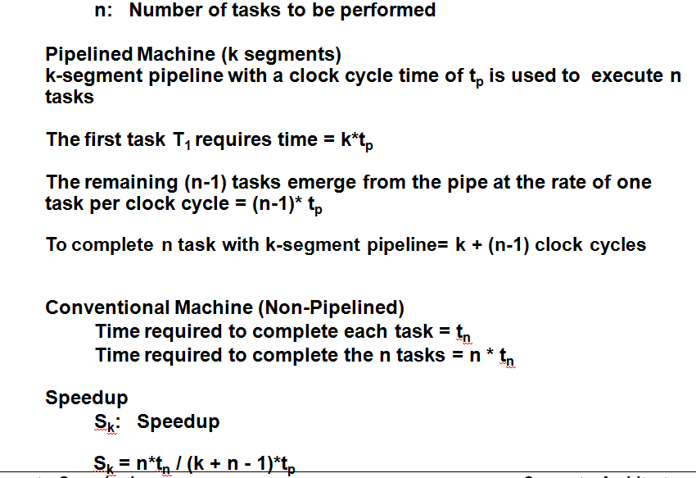
Pipeline Speedup

Slide 6
Q1. In certain scientific computation it is necessary to perform the arithmetic operation (Ai+Bi)*(Ci*Di)
Specify the pipeline configuration to carry out this task.
List the content of all registers of all the registers in the pipeline for i=1 to 6.
Q2. Draw a space time diagram for a six-segment pipeline showing the time it takes to process eight tasks.
Q3. A non-pipelined system takes 50ns to process a task. The same task can be processed in a six-segment pipeline with a clock cycle of 10ns. Determine the speedup ratio of the pipeline for 100 tasks.

Slide 10
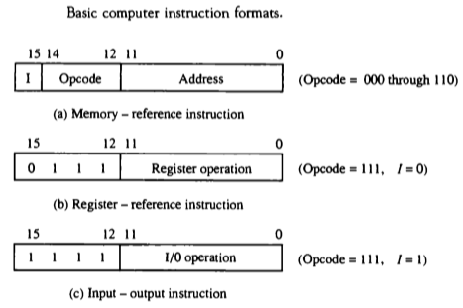
Computer Instructions
The basic computer has three instruction code formats.
Each format has 16 bits.
The operation code(op-code) part of the instruction contains three bits and the meaning of remaining 13 bits depends upon the op-code encountered.

Slide 11
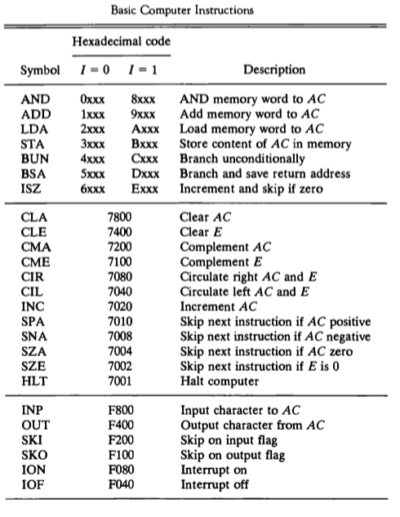
Computer Instruction Set

Slide 12
Instruction Cycle
The program is executed in the computer by going thru a cycle for each instruction.
In basic computer, each instruction cycle consists of the following phases:
Fetch an instruction from memory.
Decode the instruction.
Read the effective address from memory.
Execute the instruction.

Slide 13
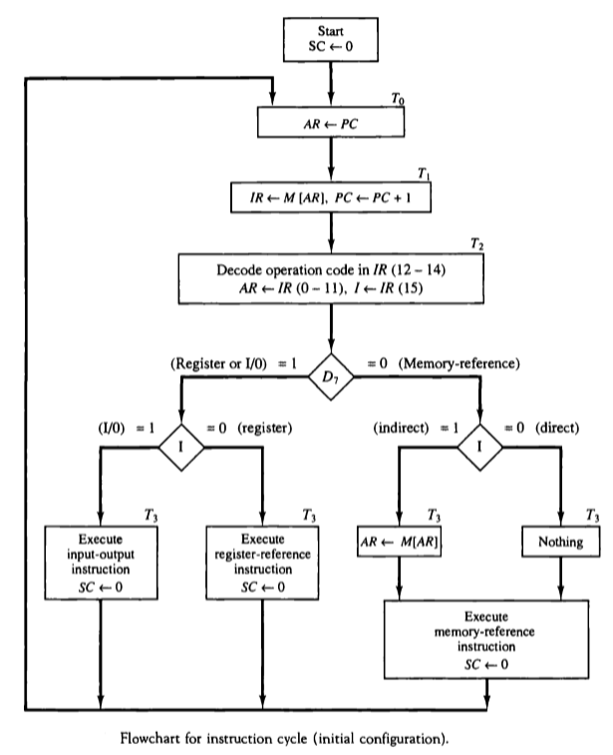
Instruction Cycle

Slide 14

Instruction Cycle
Micro-operations for fetch & decode

